Slide 1
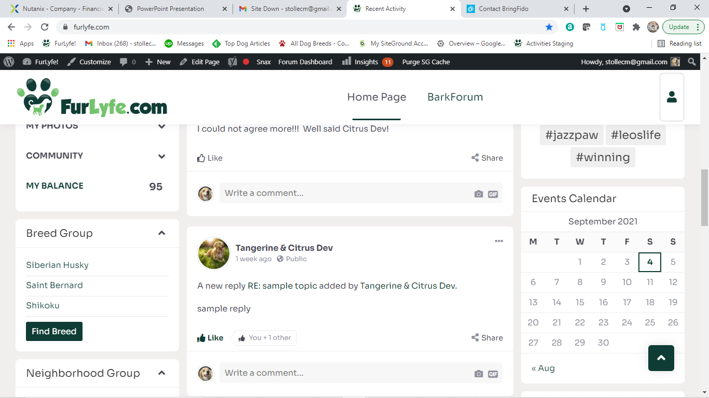
Allow administrators to have unlimited groups.
Only display three at a time
Include a scroll bar to navigate to other groups

