Slide 1
Clarification on messages and notifications
Feedback on screen shots: I want to keep the invite friends section
comment : we need to keep the invite friends section but not send the invitation on the personal message invitations only need to be share on the email ?
When a user is invited to an event they should receive a notification and an email. They should not receive a message. Please see following slides for clarification.

Slide 2
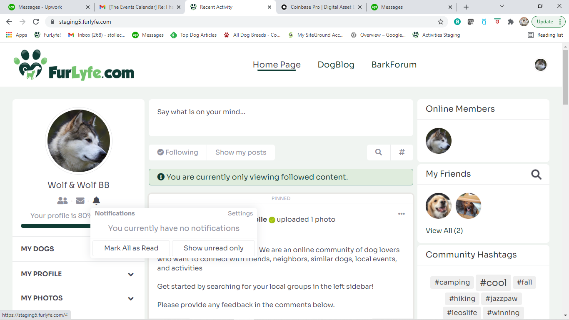
Clarification on messages and notifications
When a friend is invited, they should receive a notification and an email
Shown in the box is the notification section

Slide 3
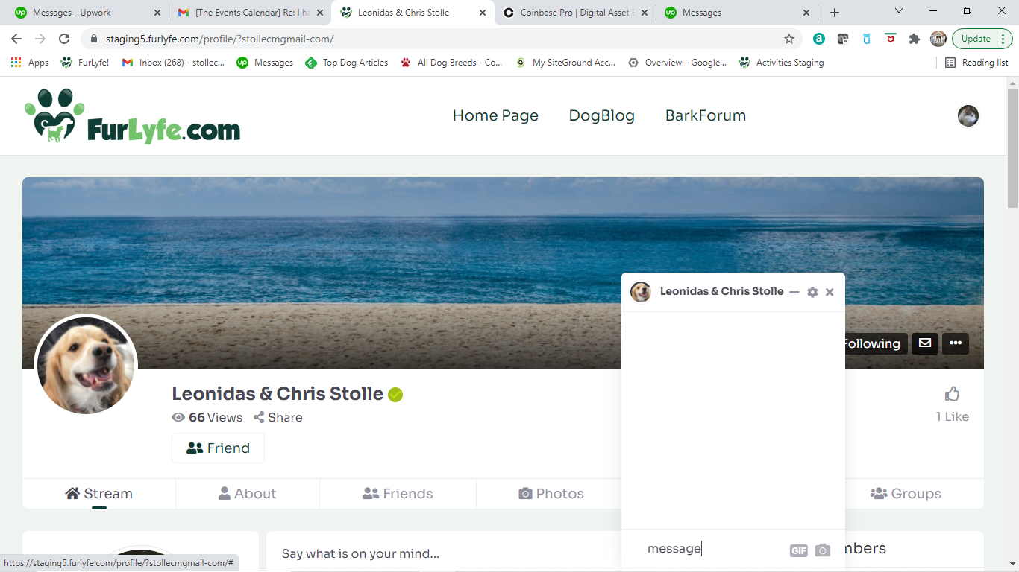
Clarification on messages and notifications
comment : we need to keep the invite friends section but not send the invitation on the personal message invitations only need to be share on the email ?
Correct, no need to send personal message. Only email and notification.

