Slide 1
Feedback Item 1

Slide 2
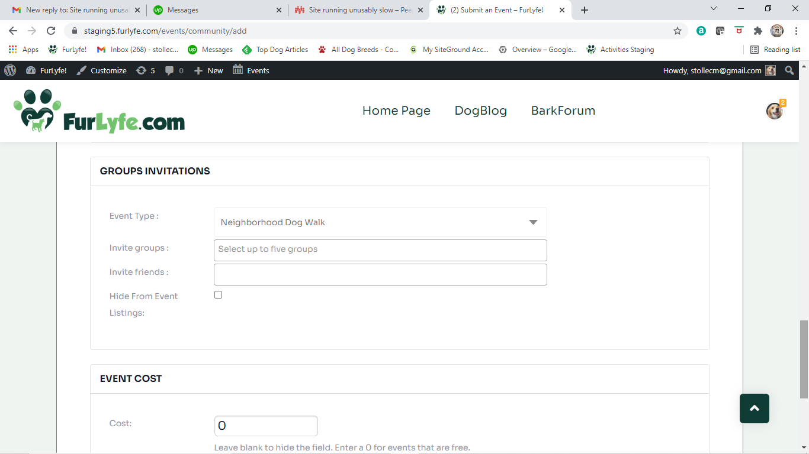
I would like Event Type to be a separate block. I would like the event type block at the top of the form. I would like
Event Type to be required

Slide 3
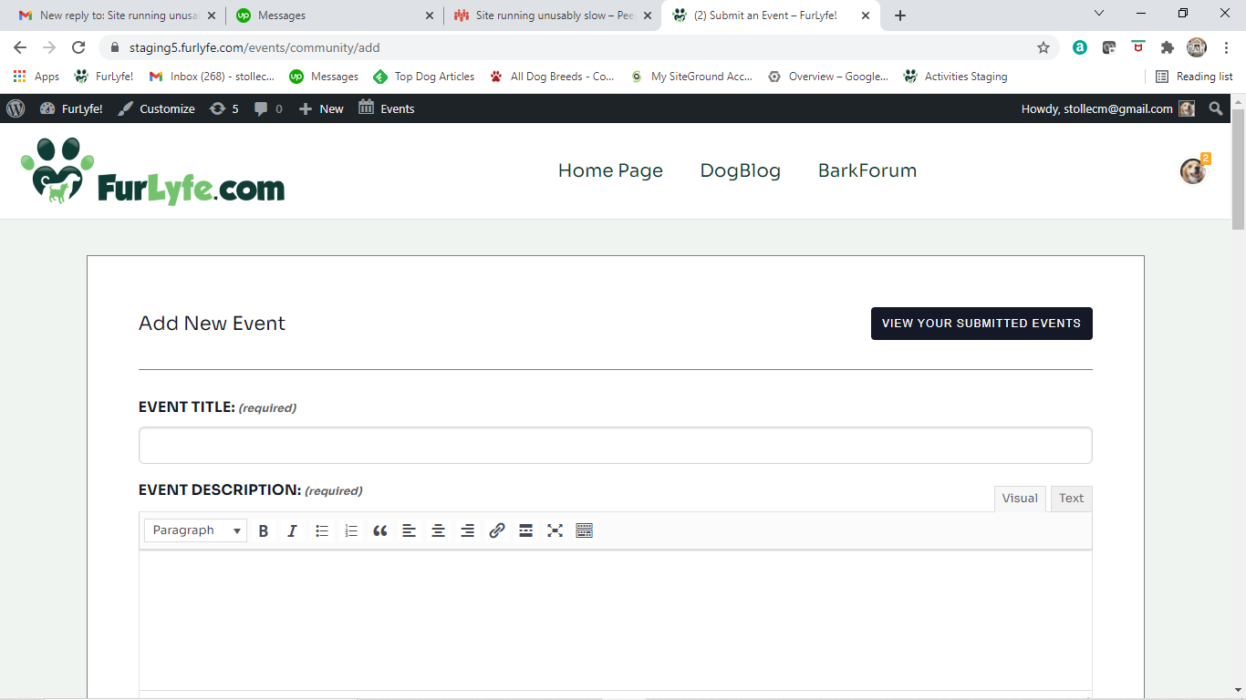
I would like EVENT TYPE to be the first block on the form
The event type selected should still control the group invitations.

Slide 4
Feedback Item 2

Slide 5
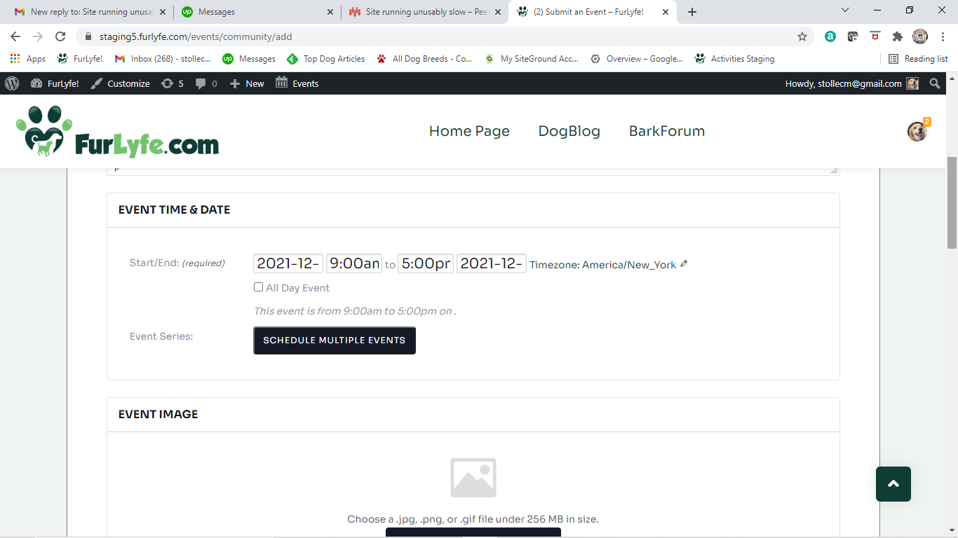
Full date and time do not fully show.

Slide 6
Feedback Item 3

Slide 7
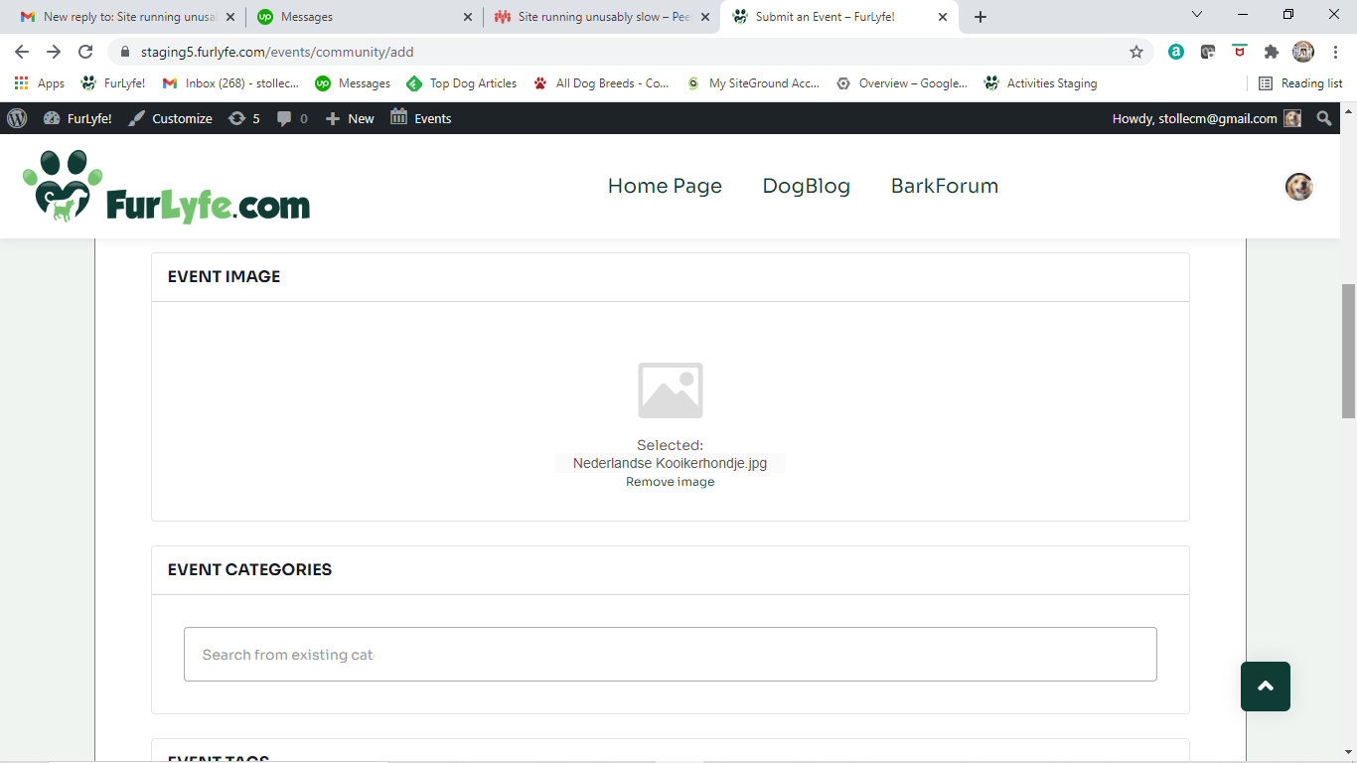
Image did not load?

Slide 8
Feedback Item 4

Slide 9
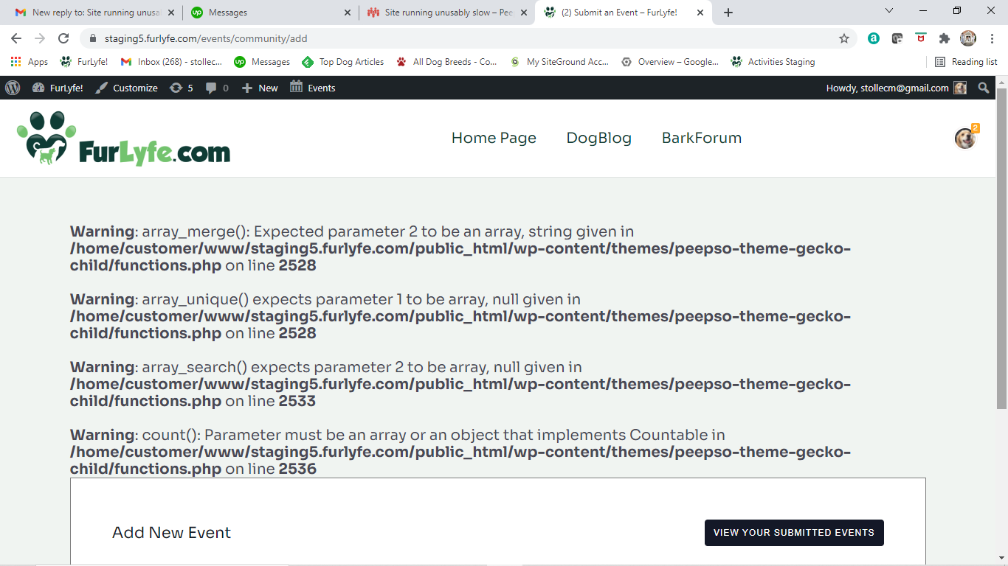
This was the display I received when I submitted event. I did not get an event invite. The event did not show up in my events

