Slide 1
Task 1 Change Form Order
Swap the order of the add dog form and the additional information form.
Add green asterisks for required fields

Slide 2
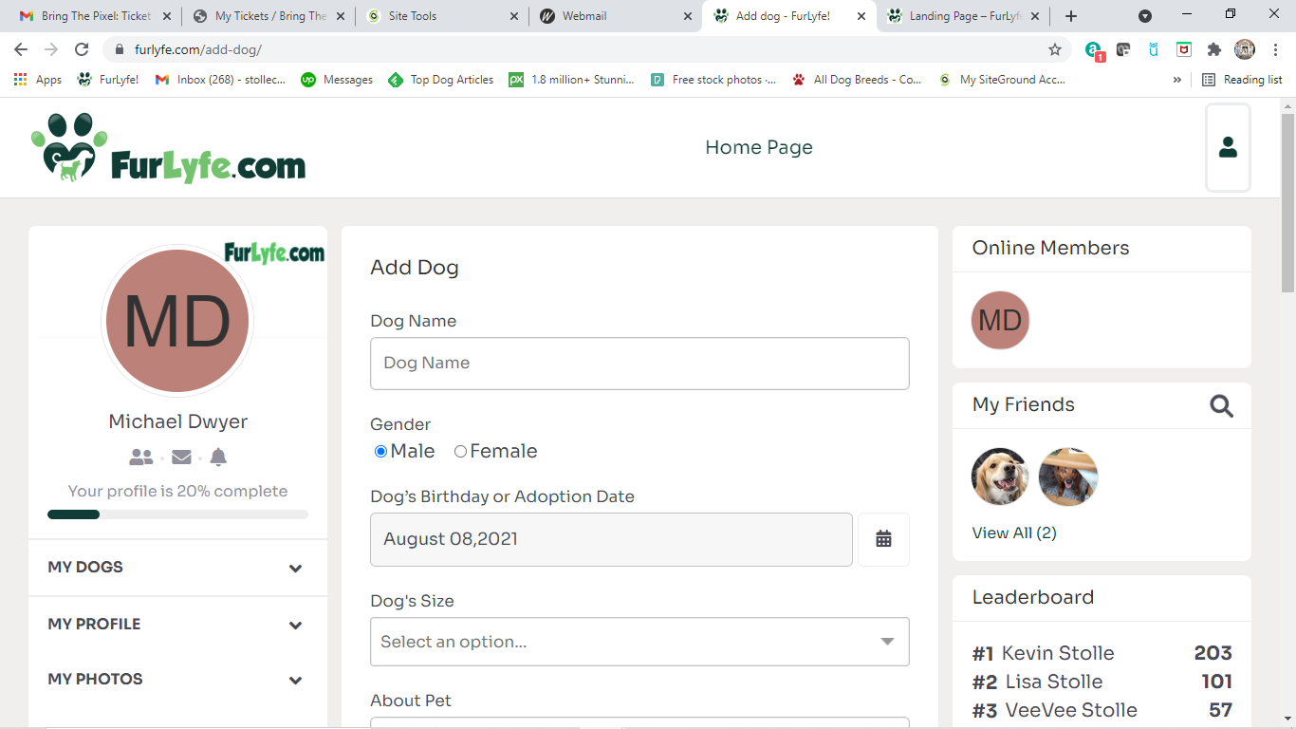
When I register, the add dog form comes up first. This form should be second.
Please add asterisks to required fields. I would like a color that matches the dark green
If possible.

Slide 3
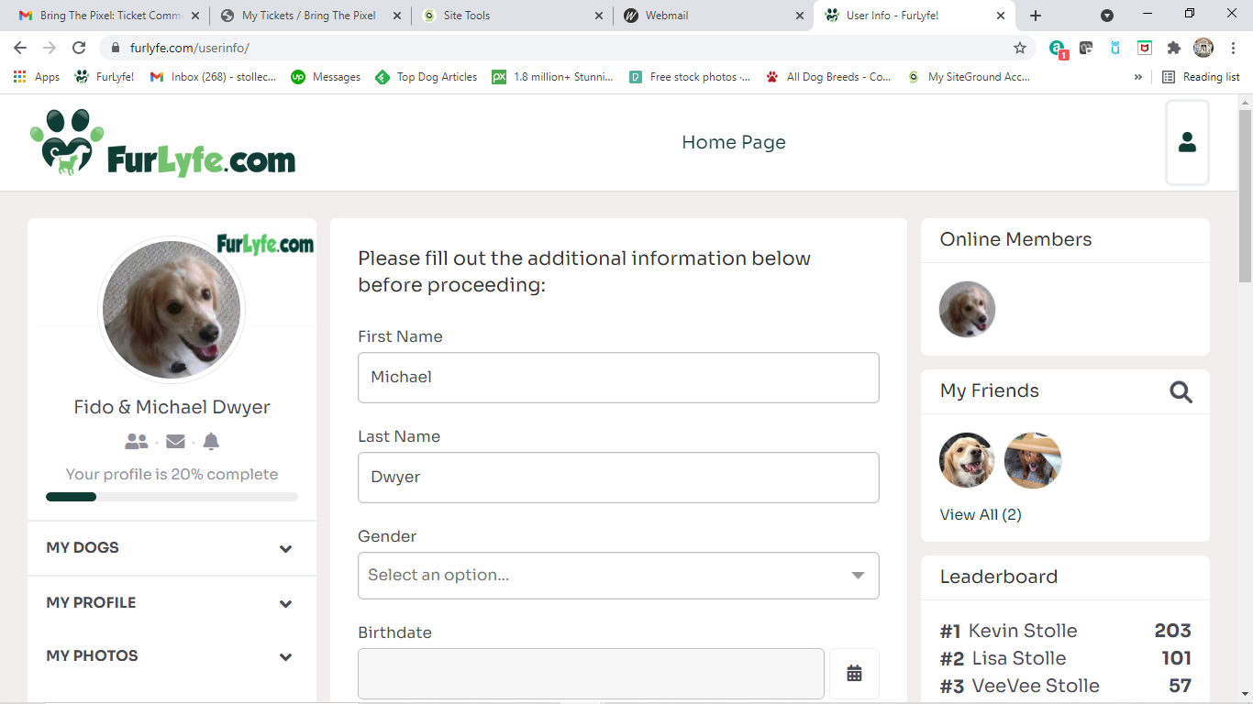
When I register, the additional information form comes up second.
This form should be first.
Please add asterisk to required fields. Make asterisks dark green to match
Theme if possible.
I would like the new tab to have the same
Functionality and customizability as Bimber,
But still be compatible with Peepso and use the
Same users information.

Slide 4
Task 2: Fix task bar issue

Slide 5
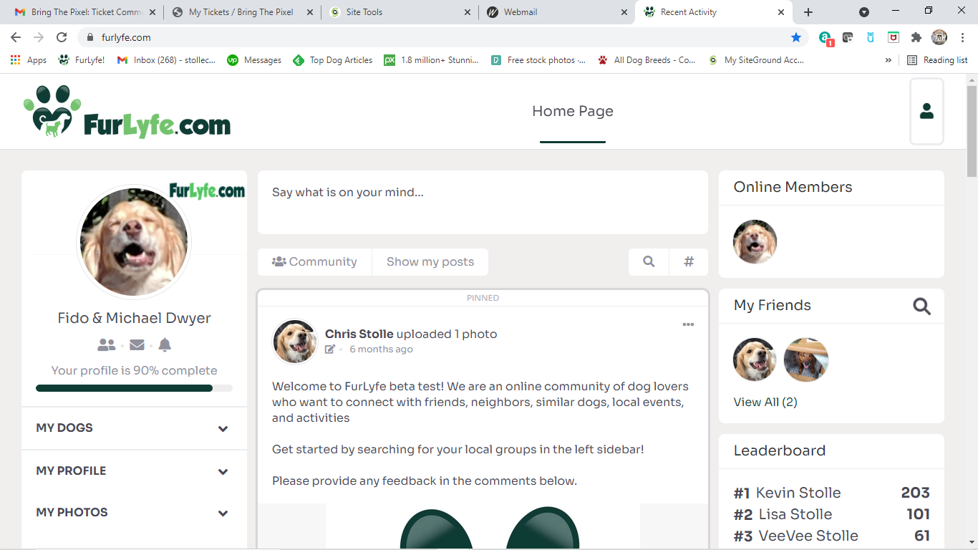
The 90% bar is showing because I selected “no” for “in the dog industry”
Previously we changed this, so that if I select “no” then I will get 100%.
Somehow it has reverted back. Please update.

Slide 6
Task 3: Add item to form for “add dog”
Add a new form field “Gets along with”
Dropdown content will include
All Dogs
Small Dogs Only
Large Dogs Only
Just people
This field should be optional

Slide 7
Add a new field after Dog’s size
Add New Field

Slide 8
Task 4: Change Fill Word

Slide 9
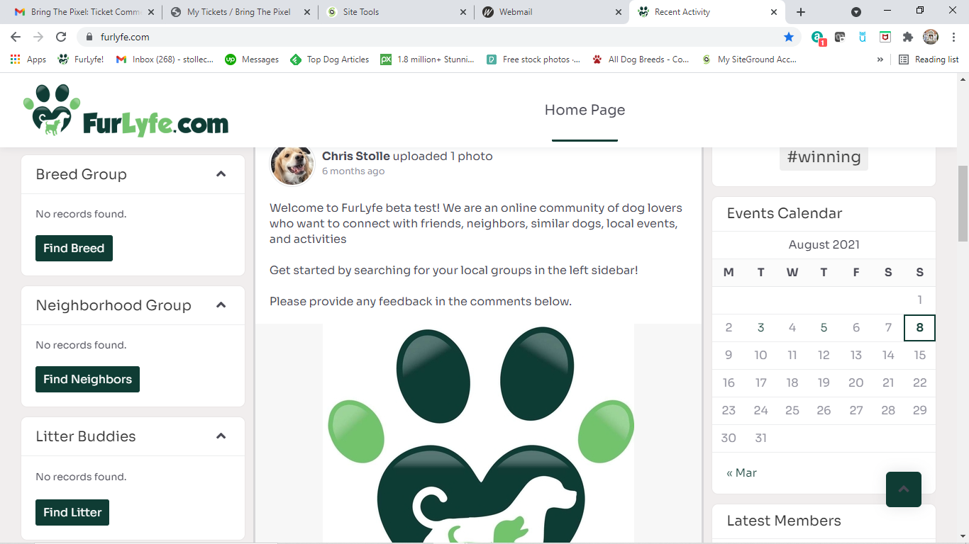
Change fill words from”no records found” to “find your breed group here”
Change fill words to “find your neighbors here”
Change fill words to “find your dog’s litter here”

Slide 10
Task 5: Adjust landing page buttons
The custom buttons on the landing page (Find Breed, Find Neighbors, Find Litter, Community) currently redirect to a content not available page
I would like these buttons (when a user is not logged in or a new user clicks) to redirect to the registration/login page

Slide 11
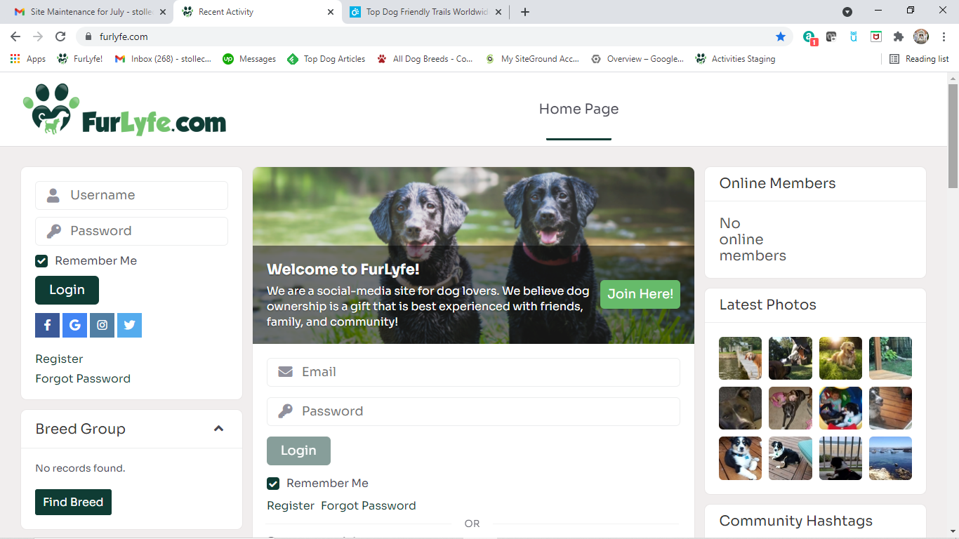

Slide 12
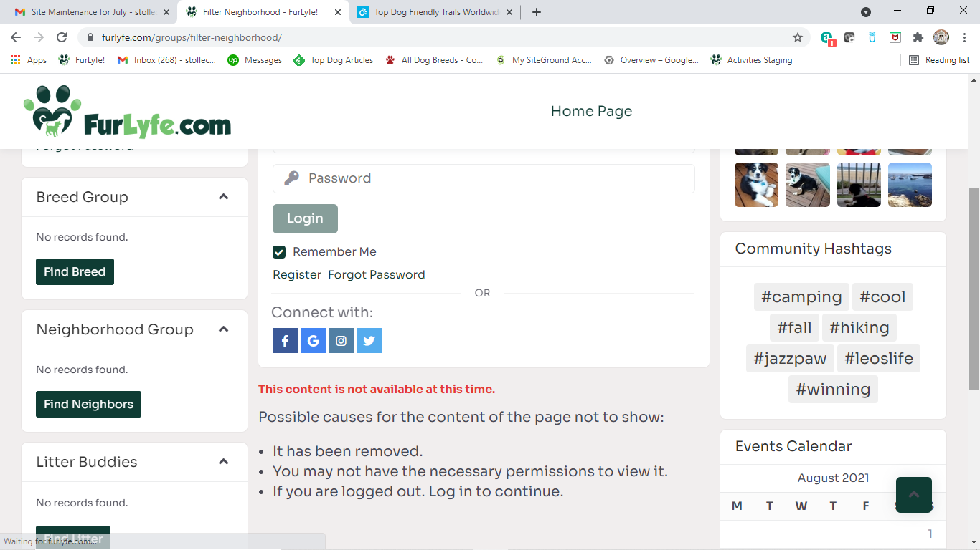
Change fill words from”no records found” to “find your breed group here”
Clicking these buttons on the “landing page” will
Redirect to this display. I would like to redirect to the
Login/registration page shown on the next slide
Change fill words to “find your neighbors here”
Change fill words to “find your dog’s litter here”

Slide 13
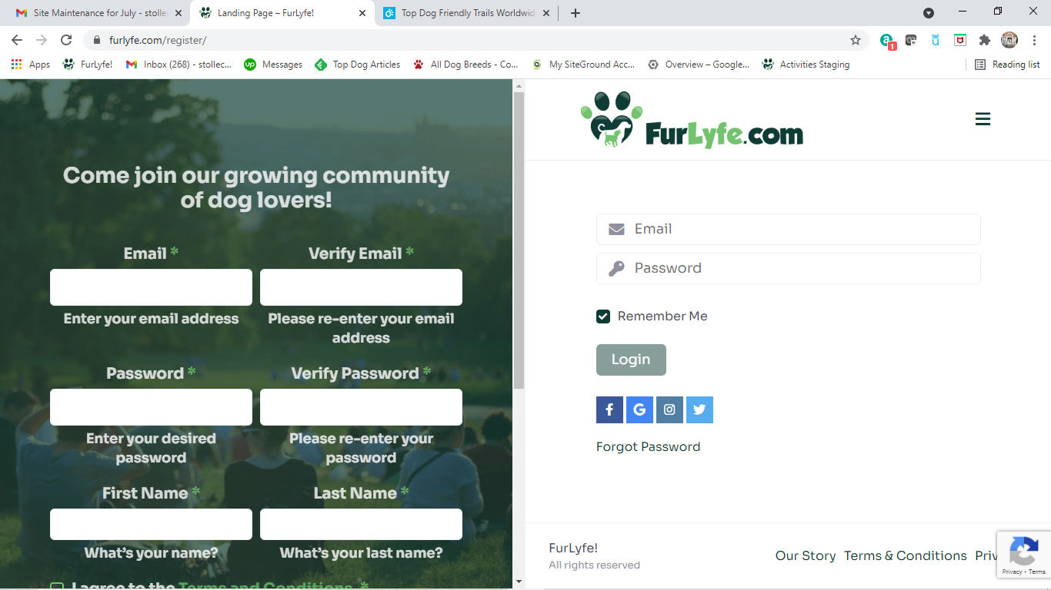
Change fill words from”no records found” to “find your breed group here”
Change fill words to “find your neighbors here”
Change fill words to “find your dog’s litter here”

